Slide 1
Md. Abdul Malek Assistant Professor, Dept. of Electrical & Electronic Engineering (EEE) Rajshahi University of Engineering & Technology (RUET)

Slide 2

Sinusoids
A sinusoid is a signal that has the form of the sine or cosine function.
A sinusoidal signal is easy to generate and transmit.
Sinusoidal voltage generated through out the world and supplied to homes, factories, laboratories, and so on.
Consider the sinusoidal voltage

Slide 3
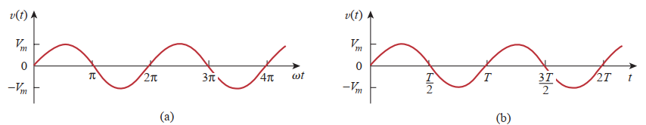

Sinusoids
Fig. 1: A sketch of V_{m} sin ωt : (a) as a function of ωt (b) as a function of t.
T= Time period of the sinusoid.
V(t) repeats itself every T seconds.

Slide 4






Sinusoids
A periodic function is one that satisfies f(t) = f (t +nT ), for all t and for all integers n.

Slide 5
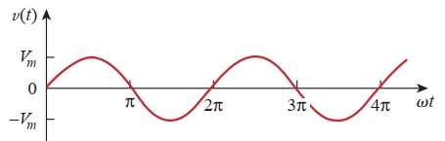



Sinusoids
Time period T of the periodic function is the time of one complete cycle.
The number of cycles per second, known as the frequency f
Unit of f is hertz (Hz)

Slide 6


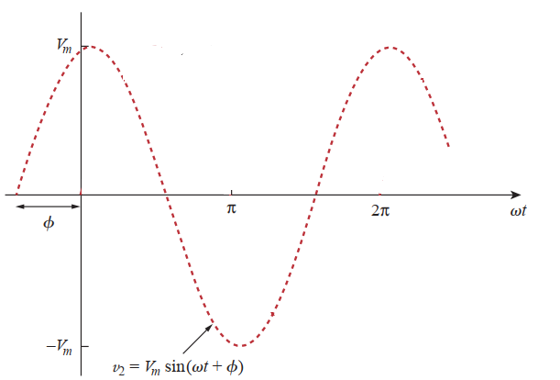

Sinusoids
Expression for the sinusoid
Where, φ is the phase.
“-” sign indicate signal start from the left side of origin.

Slide 7

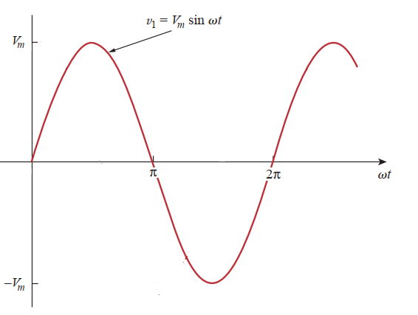

Sinusoids
“+” sign indicate signal start from the right side of origin.
If , then signal start from origin

Slide 8


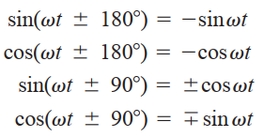

Sinusoids
A sinusoid can be expressed in either sine or cosine form.
This wave can be expressed as cosine function
When comparing two sinusoids, both sinusoids is expressed as either sine or cosine with positive amplitudes.
Sine to cosine conversion or vice versa are achieved by using the following trigonometric formula

Slide 9





Sinusoids
Example: Find the amplitude, phase, period, and frequency of the sinusoid
Solution:

Slide 10








Sinusoids
Example:
Solution:

Slide 11

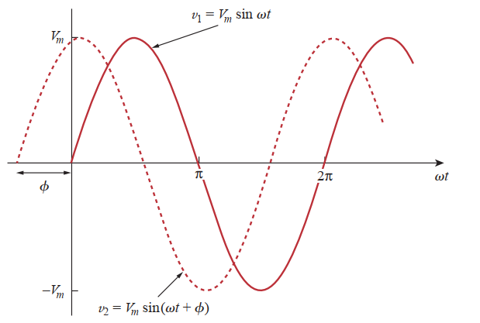

Sinusoids
Two sinusoids are
Solution:

Slide 12

Phasors
Sinusoids are easily expressed in terms of phasors.
Phasors are more convenient to work with than sine and cosine functions.
A phasor is a complex number that represents the amplitude and phase of a sinusoid.
Phasors provide a simple means of analyzing linear circuits excited by sinusoidal sources.
A complex number z can be written in rectangular form as

Slide 13
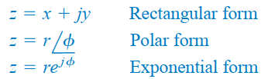
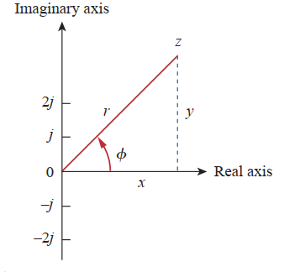
Phasors
z can be represented in three ways
The relationship between the rectangular form and the polar form is shown in following Figure

Slide 14


Phasors
we can get r and φ as
we can obtain x and y as
Complex number z may be written as

Slide 15




Phasors
Addition and subtraction of complex numbers are better performed in rectangular form.

Slide 16

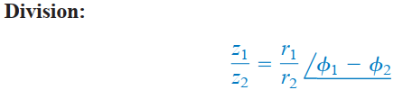
Phasors
Multiplication and division of complex numbers are better done in polar form.

Slide 17





Phasors

Slide 18

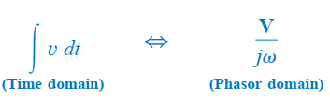
Phasors

Slide 19

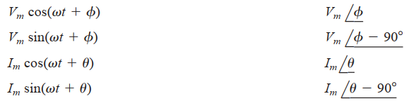
Phasors

Slide 20

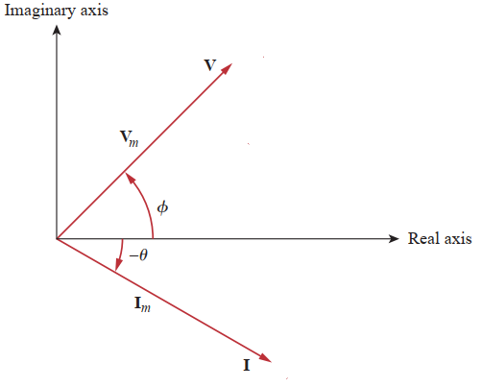
Phasors
Draw phasor diagram of

Slide 21



Phasors
Problem:
Solution:
Both sinusoids is expressed as either sine or cosine with positive amplitudes.

Slide 22




Phasors
Problem:
Solution: Phasor of i₁ is
Phasor of i₂ is,
Assume,

Slide 23




Phasors
Solution:
Transforming this to the time domain

Slide 24
Thank You

